Slide 1
Past tense / fairy tales
1-5.3

Slide 2
outline
Past tense intro (time line)(5)
What happened? GIF warm/ Worksheet sentences(5-10) (15) – irregular matching (with wrong answers)
Time pick game (what did you do)(10) (25) – contrast past present future
Fairy tale quiz (15) (40)
Candy time (5) (45)
Fairy tales

Slide 3
Now
현재
Past
과거
Will 동사
Normal : +ed
Notes:
Inquire which tense we are learning
Ask how to make
Do seevral easy examples then an irregular

Slide 4
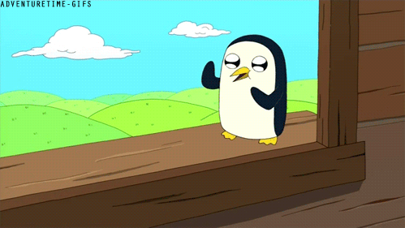
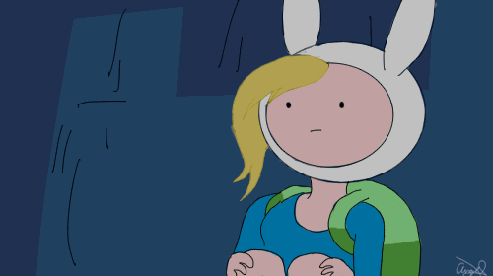
What did he do?
What did he do?

Slide 5
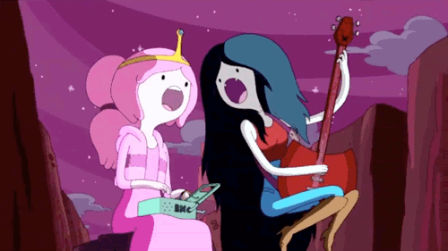
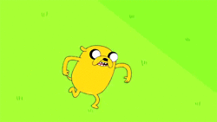
What did she do?
What did they do?

Slide 6
Not normal?
be
go
break
buy
choose
come
do
draw
eat
fall
Was/were
went
broke
bought
chose
came
did
drew
ate
fell
give
know
see
drink
sing
speak
take
wear
write
…
Gave
Knew
Saw
Drank
Sang
Spoke
Took
Wore
Wrote
…

Slide 7
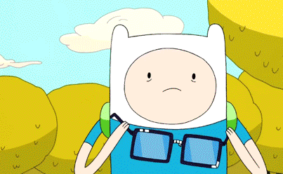
What did she do?
What did he do?
Sing → sang
wear → wore

Slide 8

A
B
C
D
E
go
be
buy
gave
came
See
Play
Watch
Go
Borrow
Eat
Make
Buy
Take a picture
Ask
F
G
H
I
J
come
sing
give
saw
see
K
L
M
N
O
was
eat
went
fall
ate
P
Q
R
S
T
sang
took
bought
take
fell
Notes:
matching game : present and past tense irregulars

Slide 9
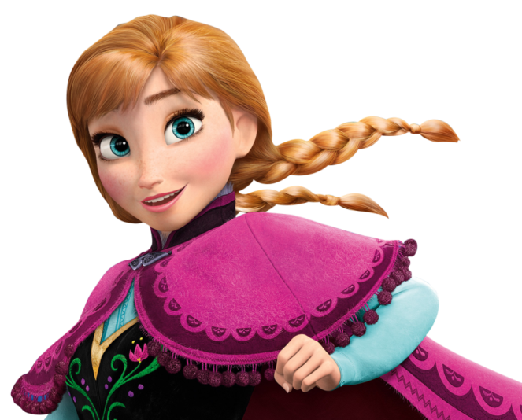
We use past to tell a story.
What did you do this morning ?
What did you do yesterday?
What did Anna do in Frozen?

Slide 10
What happened in the story of “The Farmer and the Gold Duck”?
Let’s correct!

Slide 11
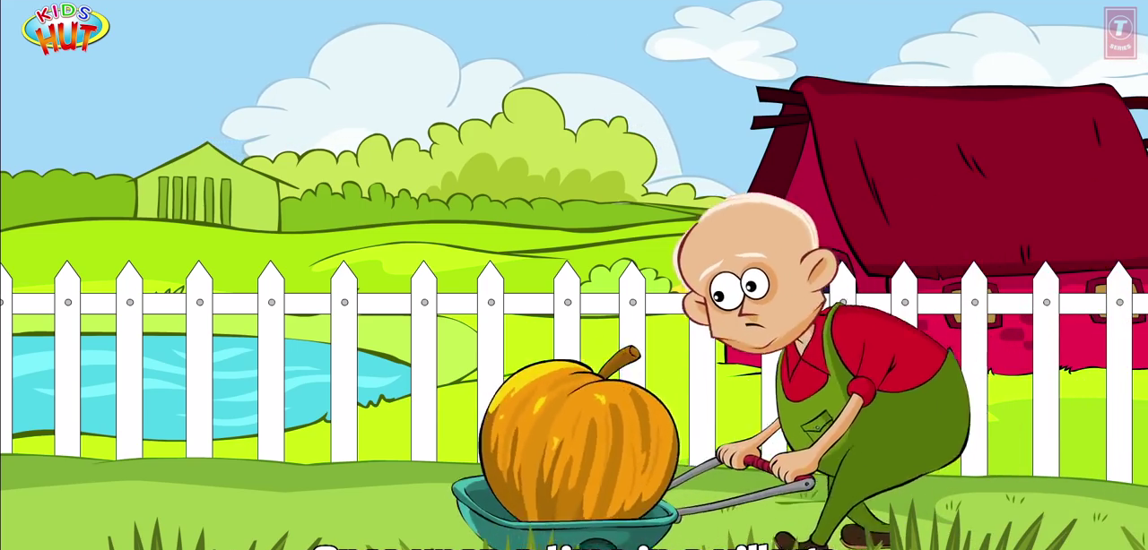
Once upon a time, there is a farmer.

Slide 12
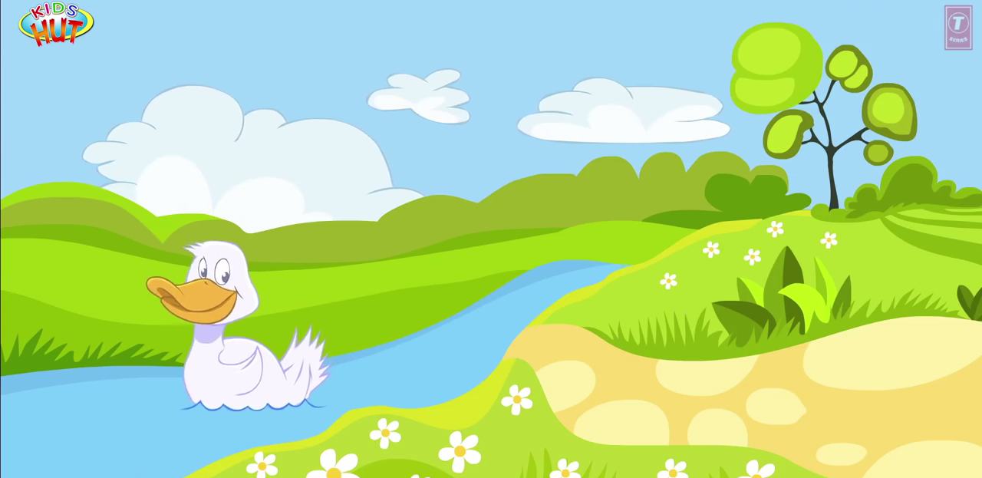
He save money and buy a duck.

Slide 13
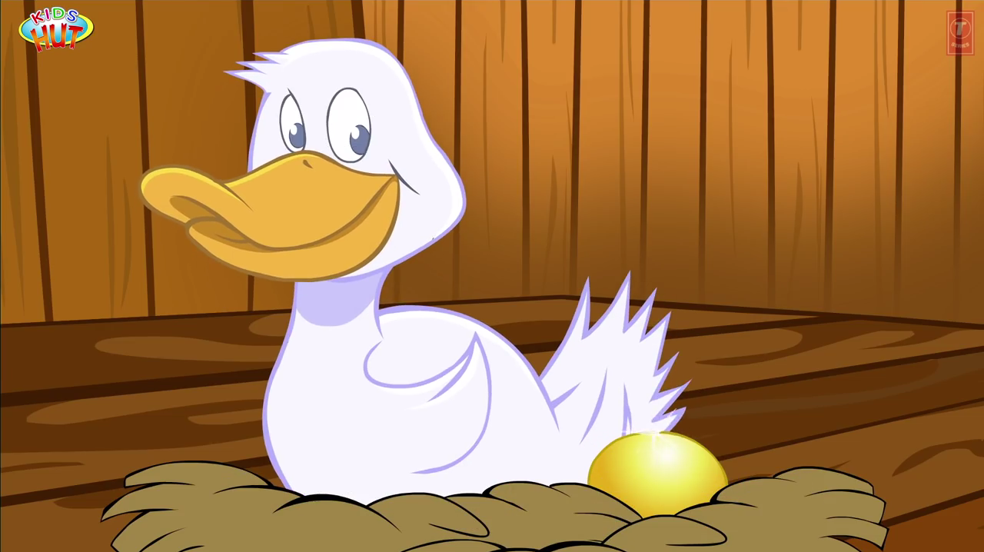
The duck make gold eggs.

Slide 14
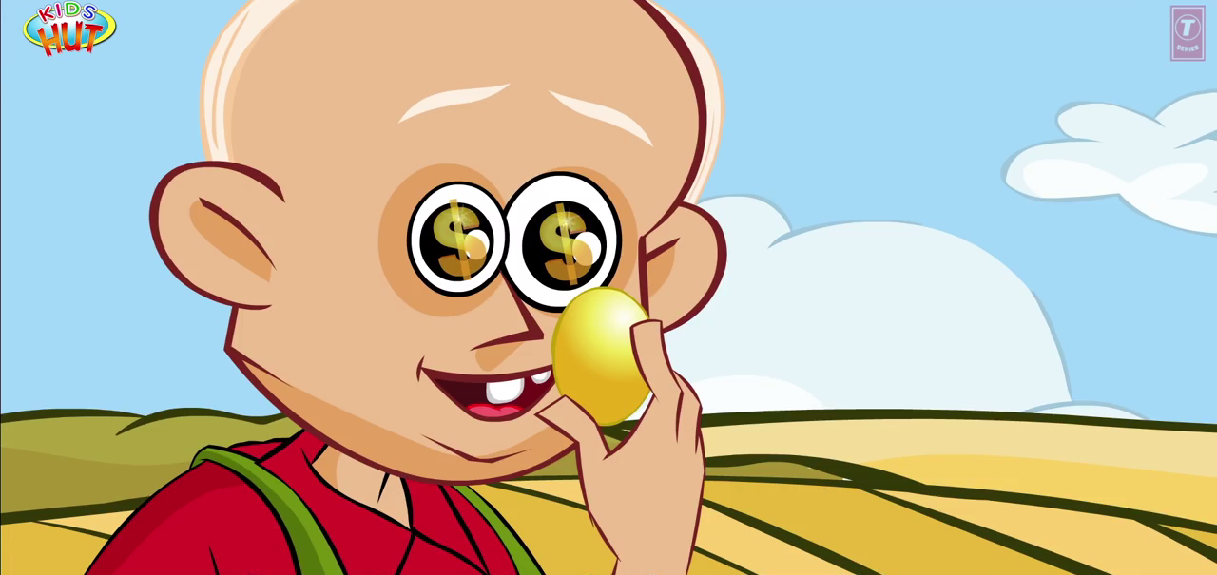
The man think “I can be rich!”

Slide 15
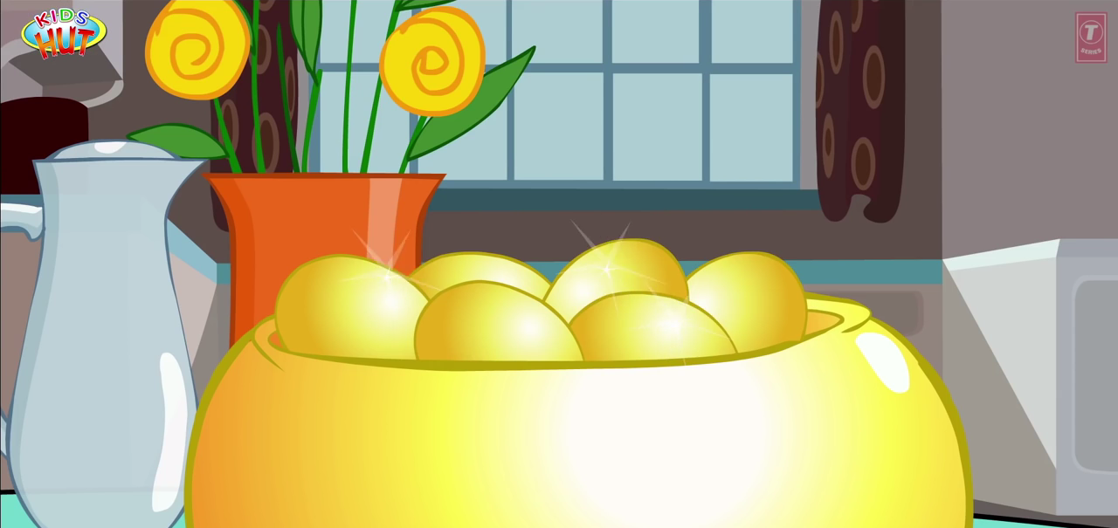
They use many gold eggs.

Slide 16
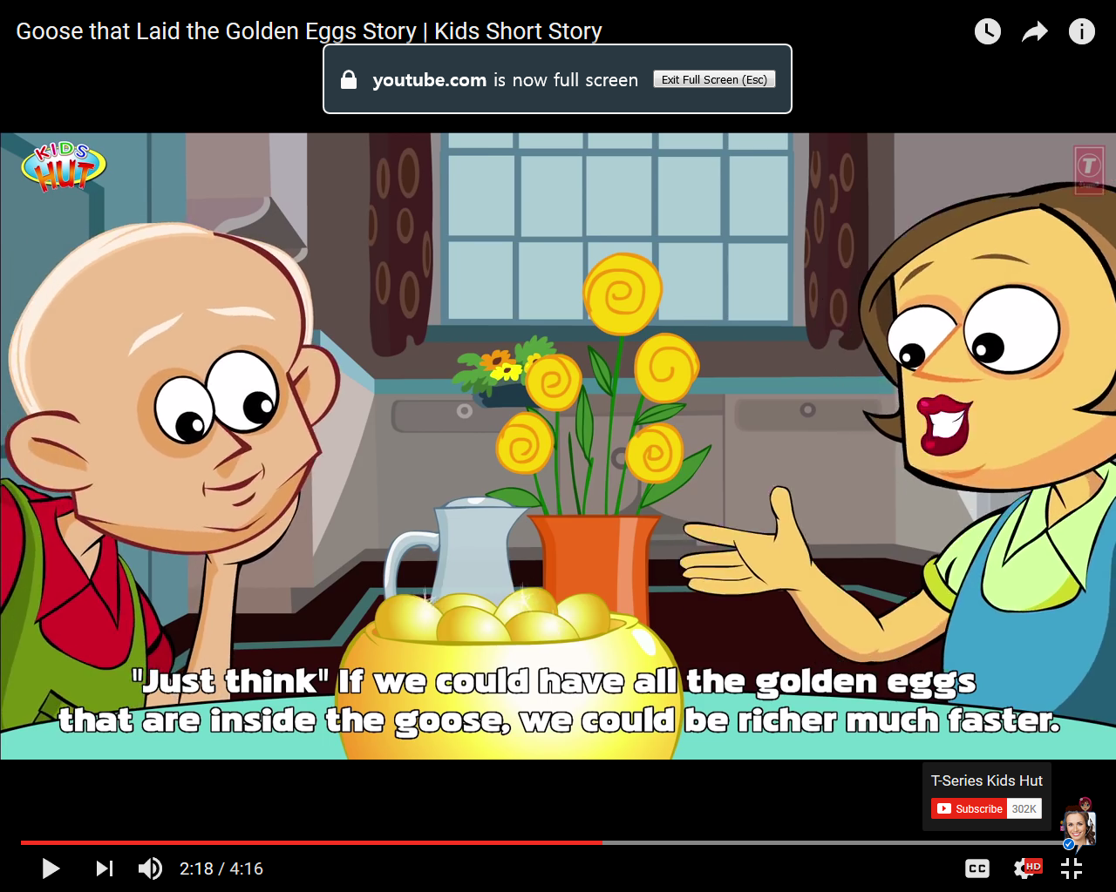
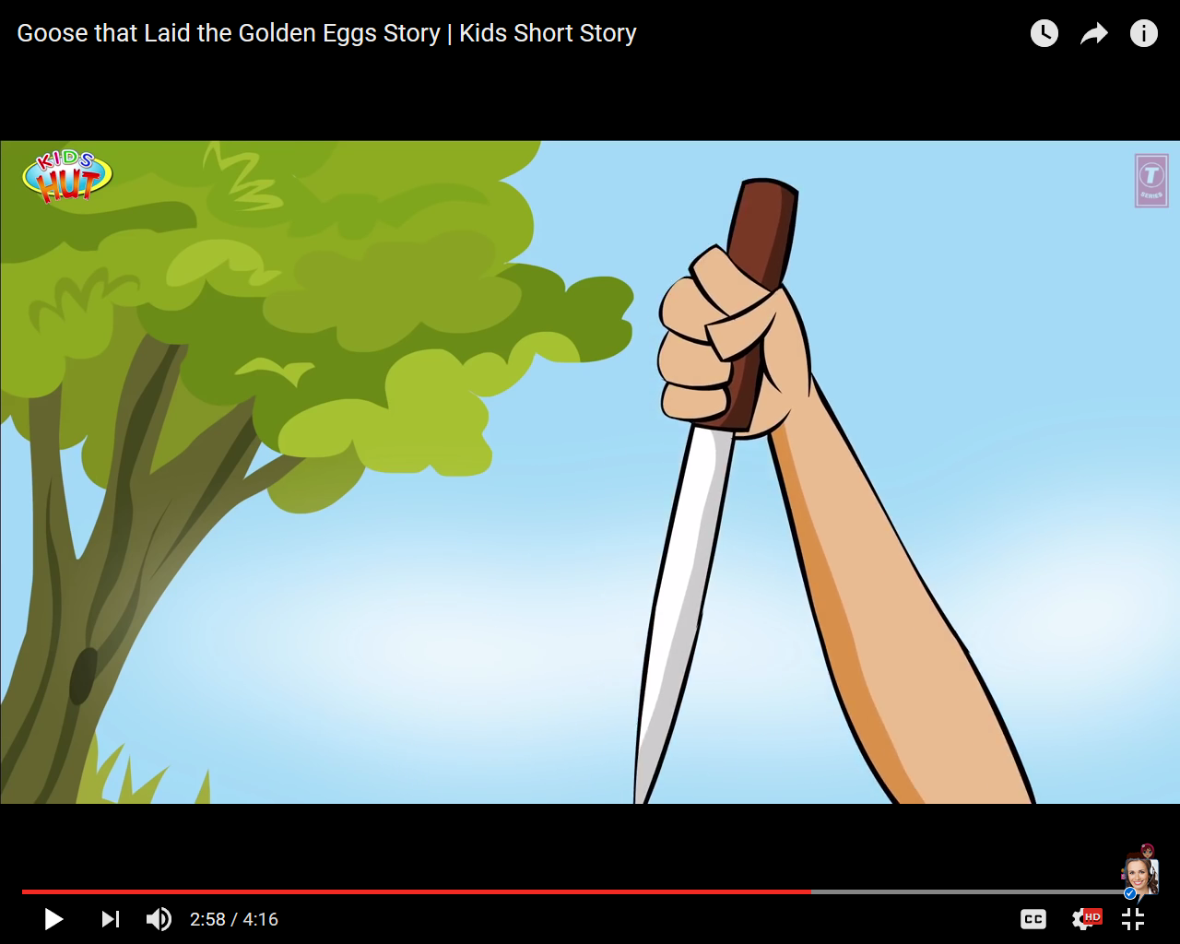
His wife say “The duck is gold! We should kill him.”

Slide 17
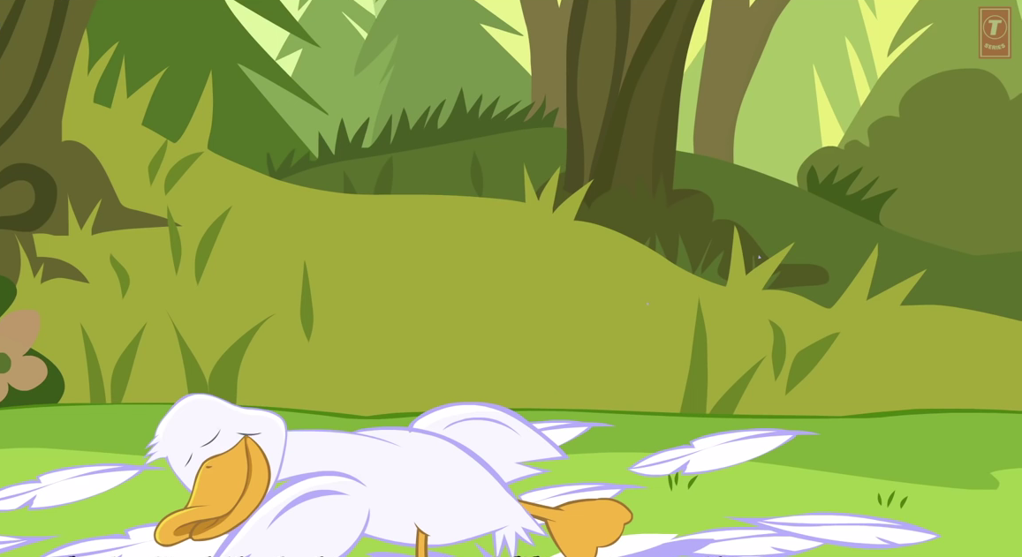
They kill the duck. He is not gold.

Slide 18
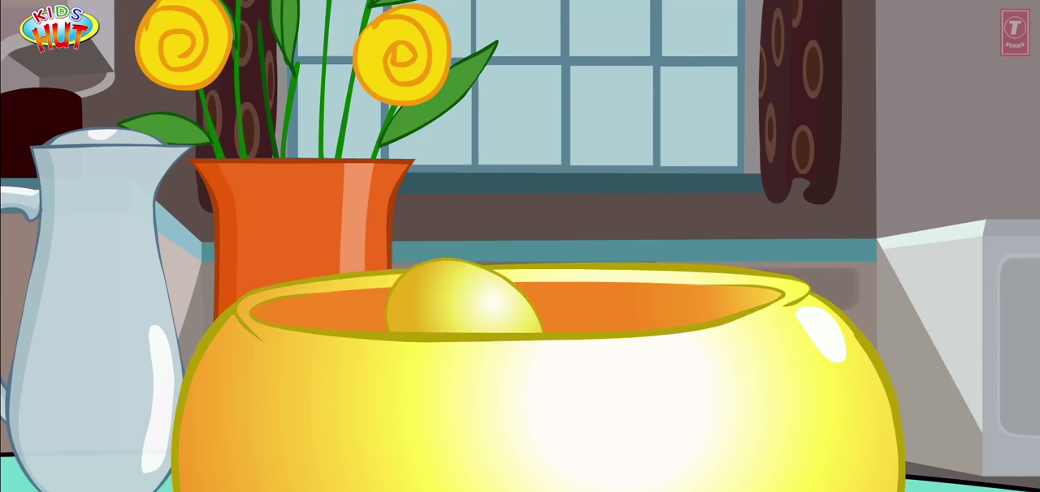
They lose the gold eggs. There are no more eggs.

Slide 19
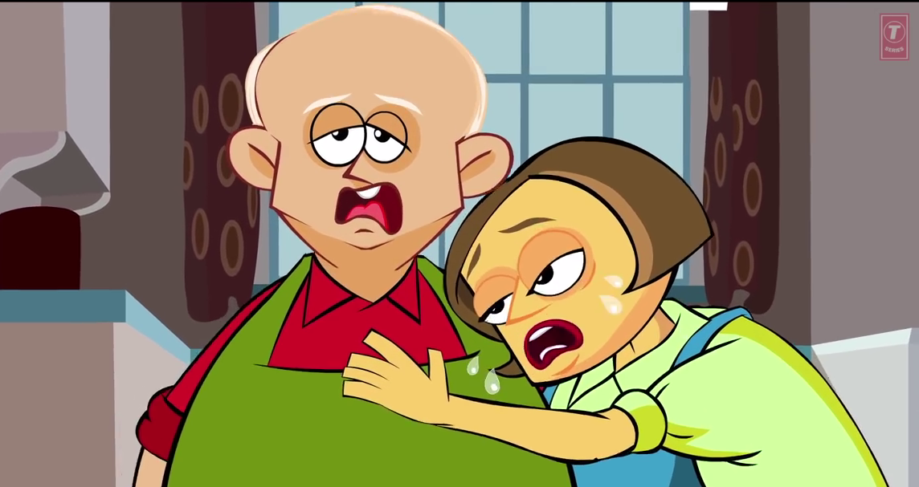
The farmer and his wife are sad.

Slide 20
Moral : a story lesson
Be thankful. Don’t be greedy.

Slide 21
Fairy tale quiz
Team game
Notes:
http://dinolingo.com/blog/2011/08/13/popular-korean-folktales-short-stories-for-kids-in-korea-with-video/#.WUhzqTeRXcs

Slide 22

Heungbu
and Nolbu
Beauty and the Beast
Cinderella
Mulan
A
A
A
A
B
B
B
B
C
C
C
C
Notes:
have them choose a question – feel free to change the stories to ones that your students are familiar with

Slide 23
Make the story. (10)
C-B-D-A-E
Nolbu was jelaous. Nolbu hurt a bird. It gave him 3 seeds.
Heungbu helped a bird. It gave him 3 seeds.
Once upon a time, there was a kind brother Heungbu and a mean brother Nolbu.
Heungbu’s seeds grew. He got gold!
Nolbu’s seeds grew. He grew a devil!

Slide 24
Correct! (+10 x 2)
was mean
Nolbu were kind, Heungbu was mean.
Heungbu got 16 seeds.
kind
3 seeds

Slide 25
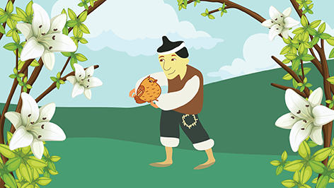
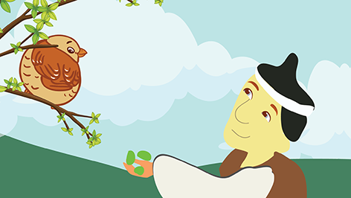
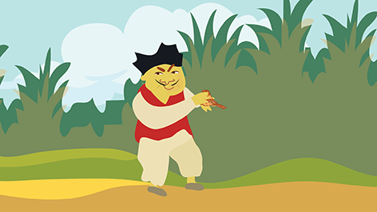
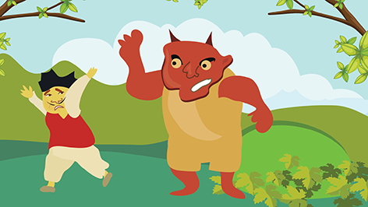
Write 4 sentences. +10 each sentence

Slide 26
Make the story. +10
C-E-D-B-A
The prince found Cinderella.
Cinderella left her shoe.
Cinderella’s sisters were mean.
Cinderella went to the party.
The fairy made Cinderella a dress.

Slide 27
Correct! (+10 x 3)
lost shoe
Cinderella lose her purse.
The prince were very ugly.
Her sisters liked her.
was handsome
hated/didn’t like

Slide 28
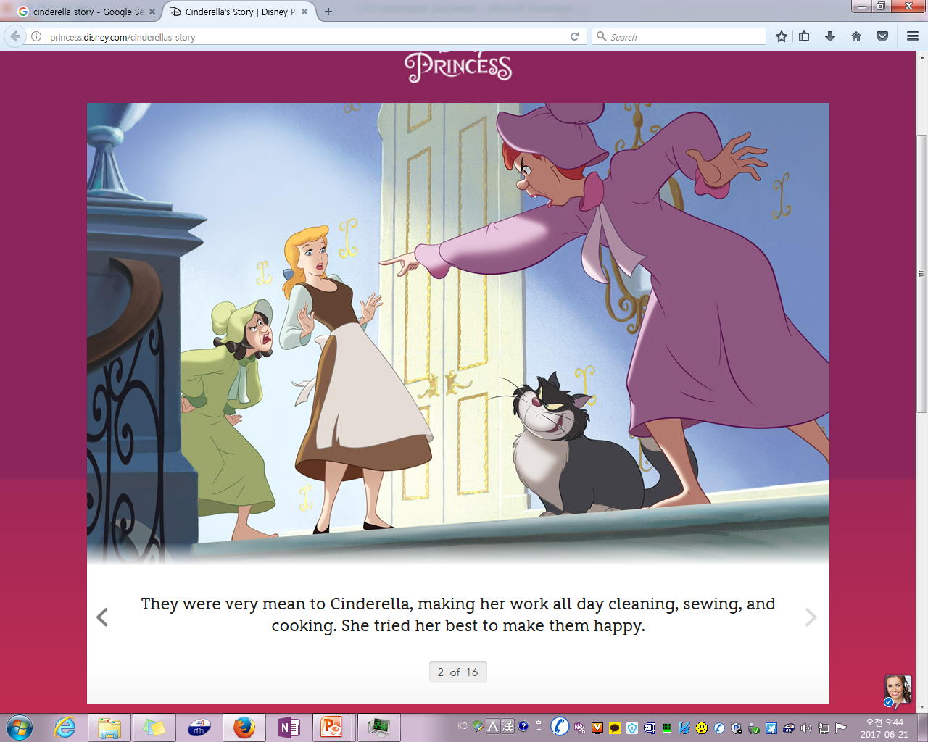
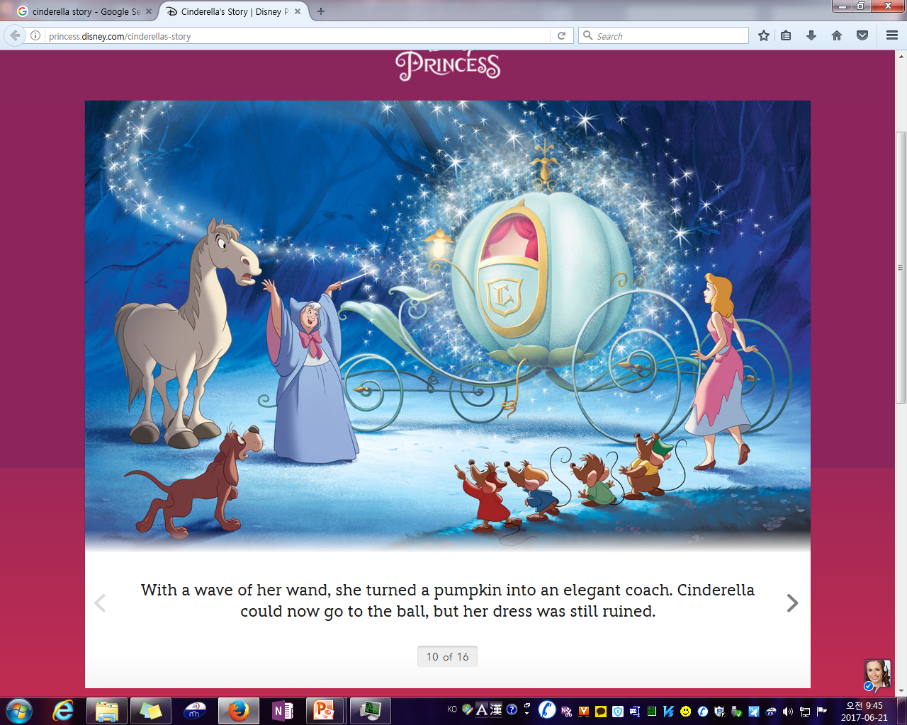
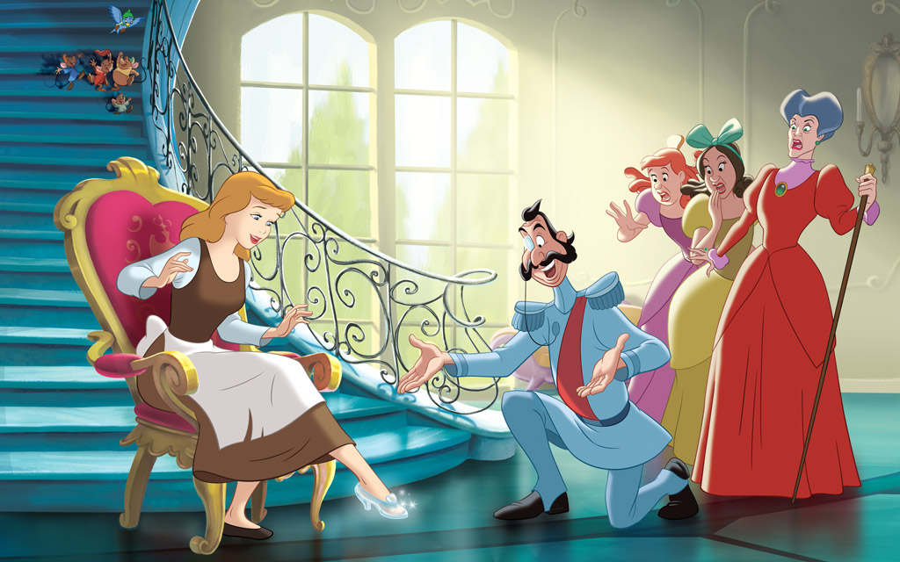
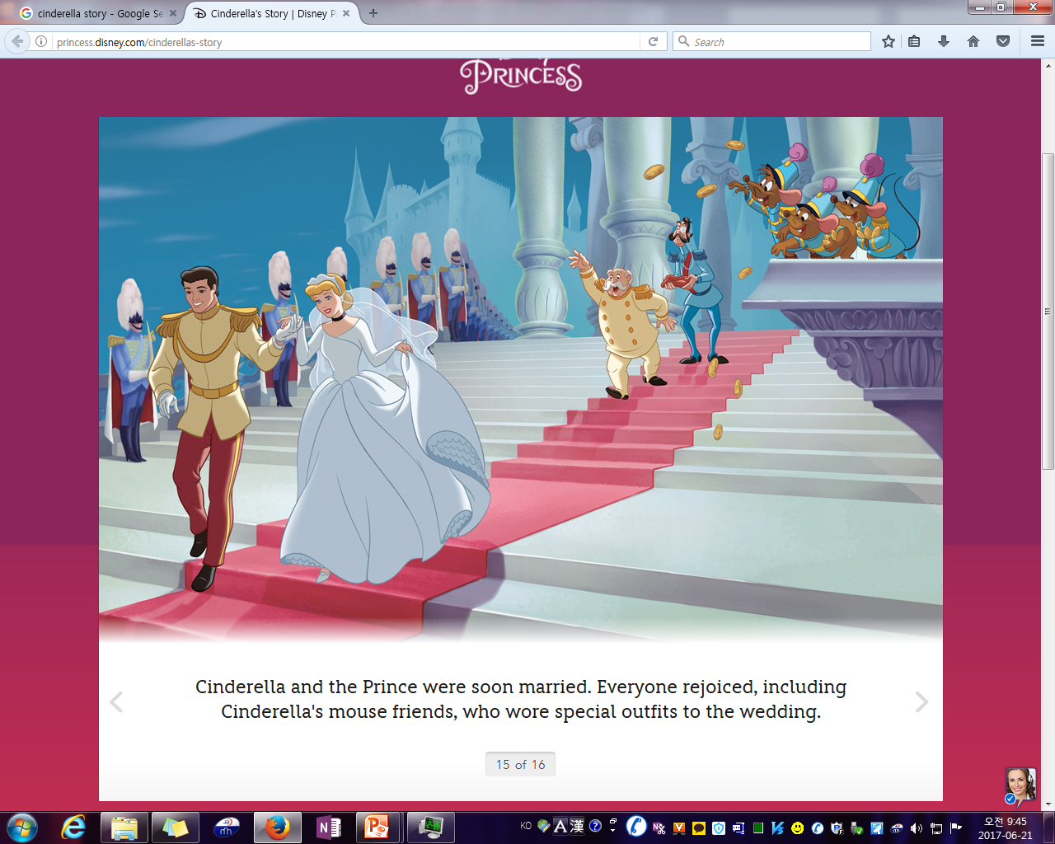
Write 4 sentences. +10 each sentence

Slide 29
Make the story. +10
A-B-D-C-E
Mulan was a Chinese girl.
The king called the army, but Mulan’s dad was sick.
Mulan saved the king.
Mulan wore boy’s clothes.
Mulan went home.

Slide 30
Correct! (+10 x 3)
was Chinese
Mulan is Korean.
Mulan was a strong boy.
The king saved Mulan.
girl
Mulan saved the king.

Slide 31
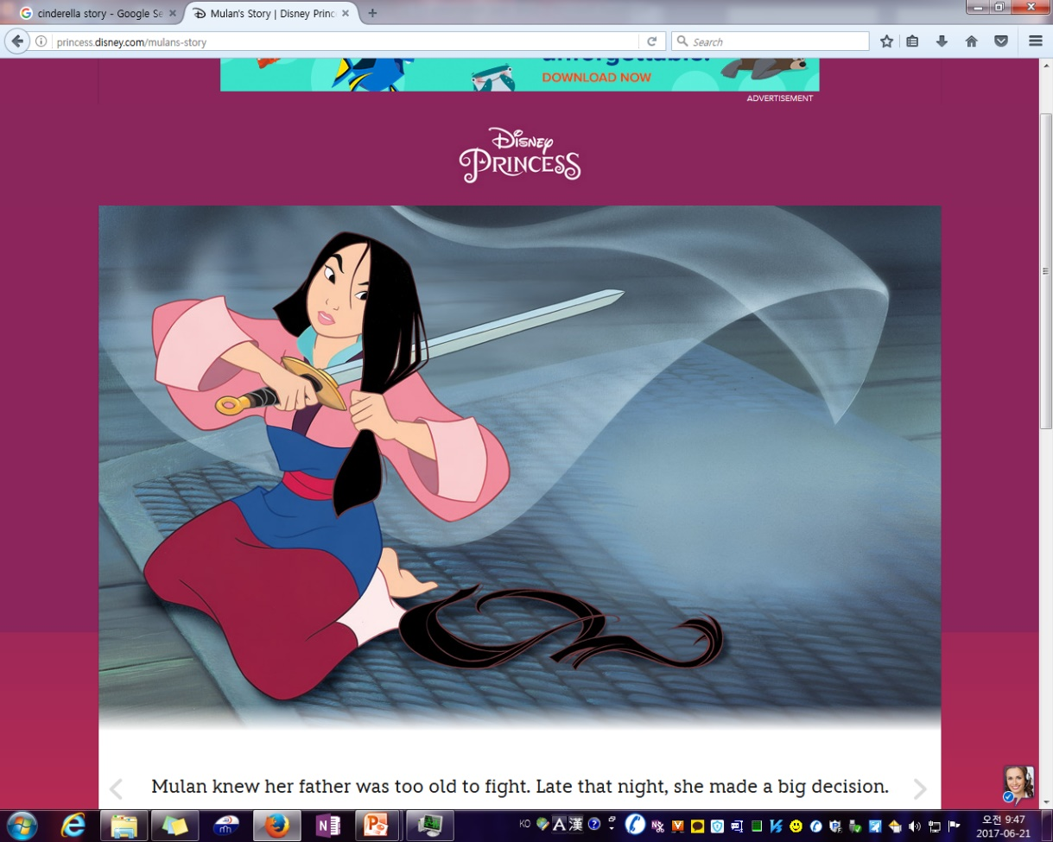
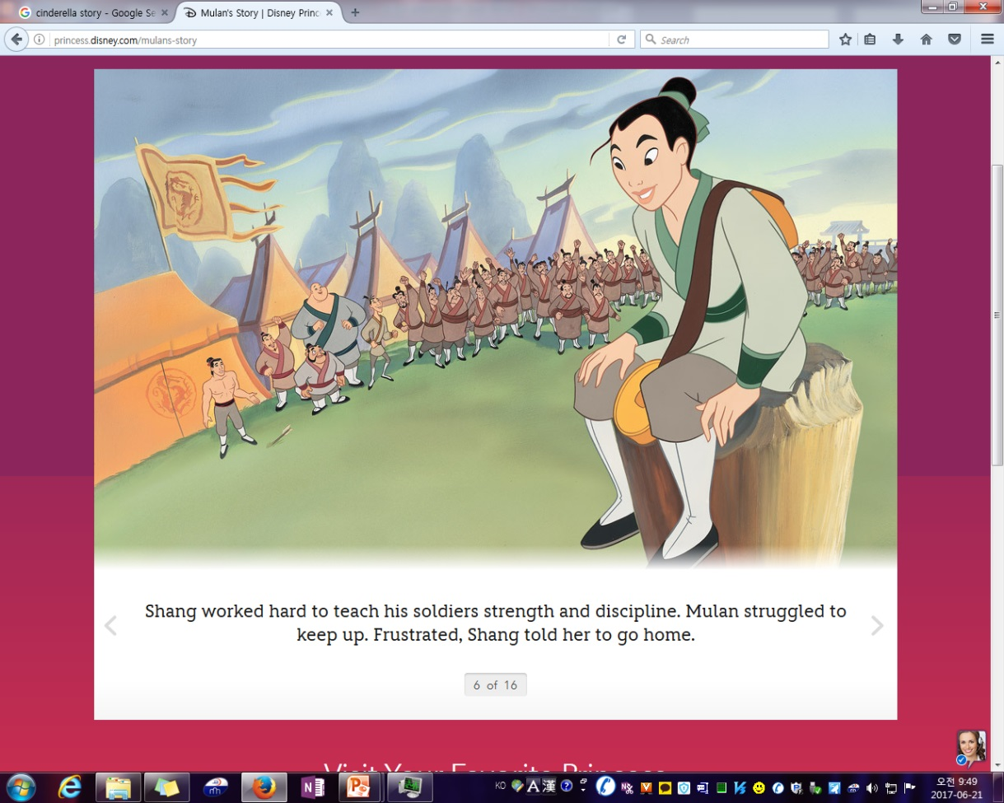
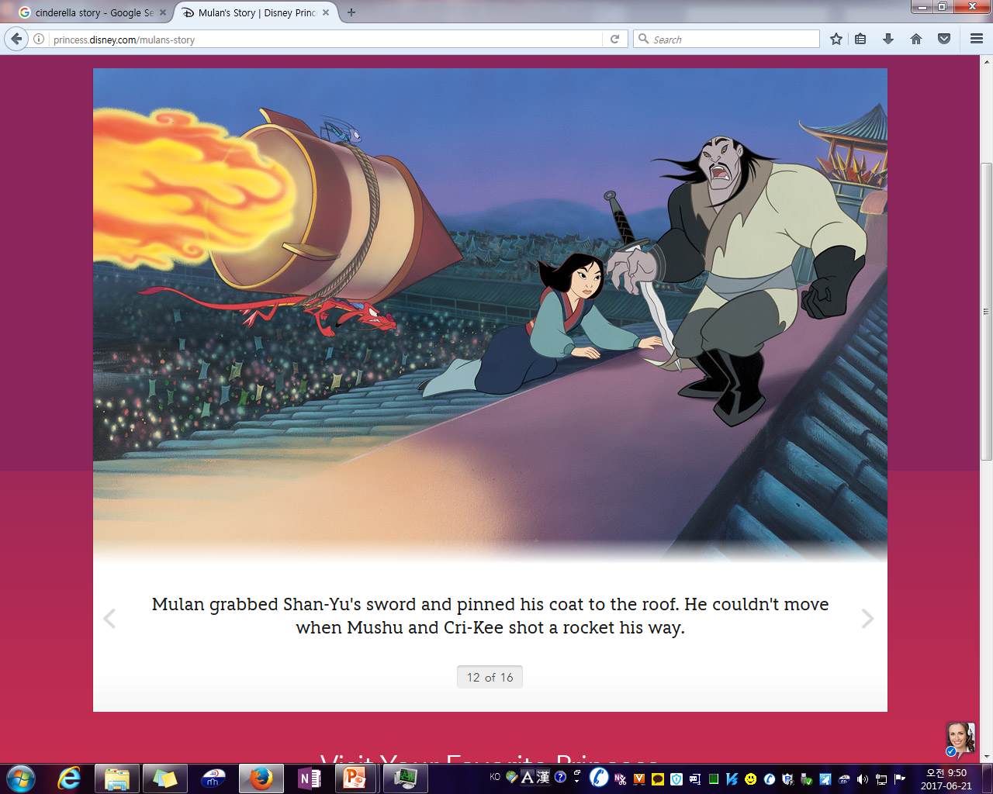
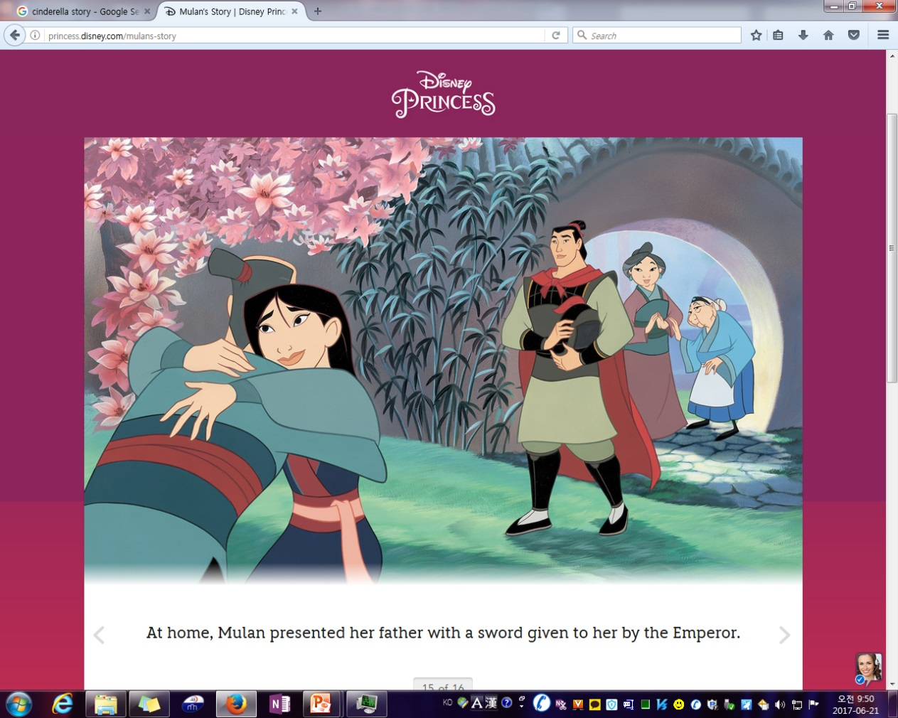
Write 4 sentences. +1 each sentence

Slide 32
Make the story. +10
B-D-A-E-C
Belle loved the monster.
Belle’s dad was in the monster’s house.
Belle cried. The monster lived!
Belle saved her father. Belle lived with the monster.
The people killed the monster.

Slide 33
Correct! (+10 x 3)
was smart
Belle is stupid.
The monster loved a princess.
The clock and teapot help Belle.
Belle
helped

Slide 34
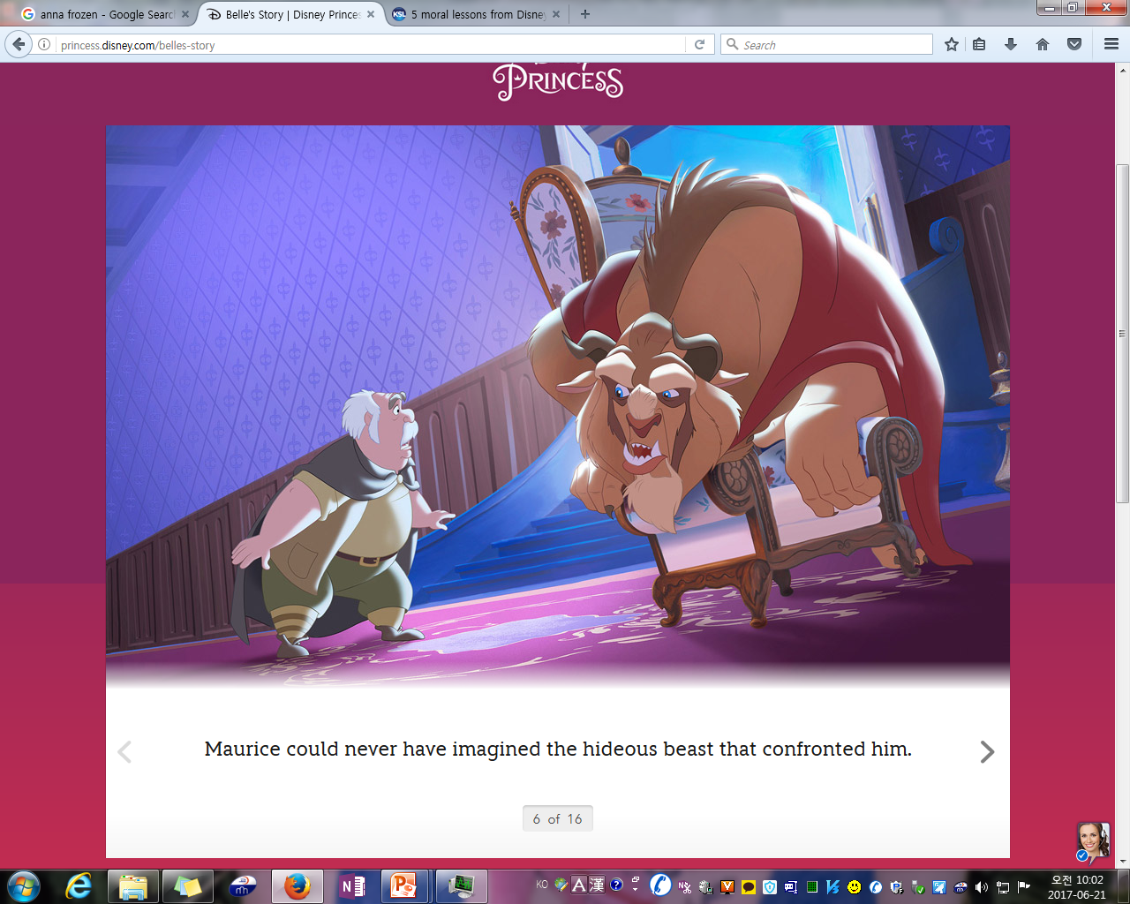
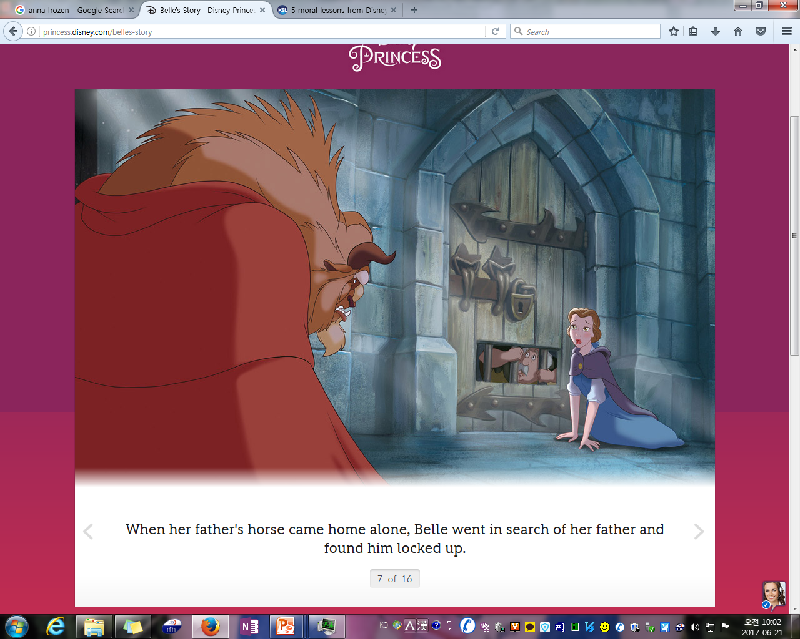
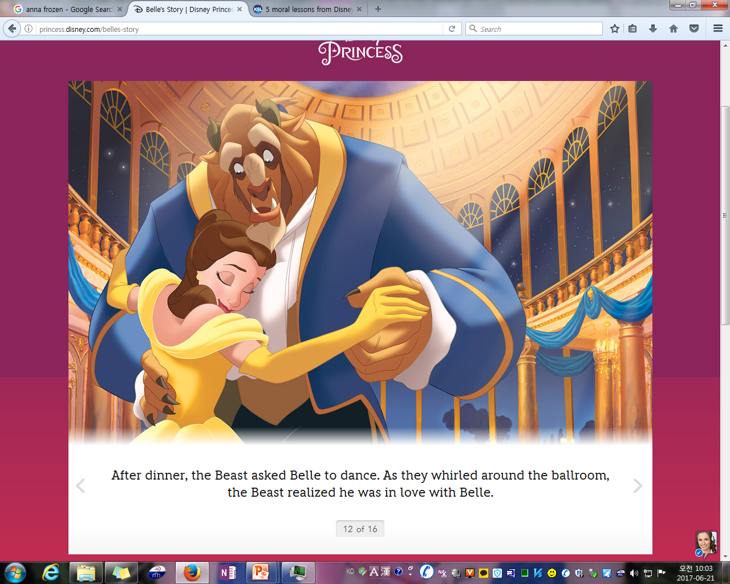
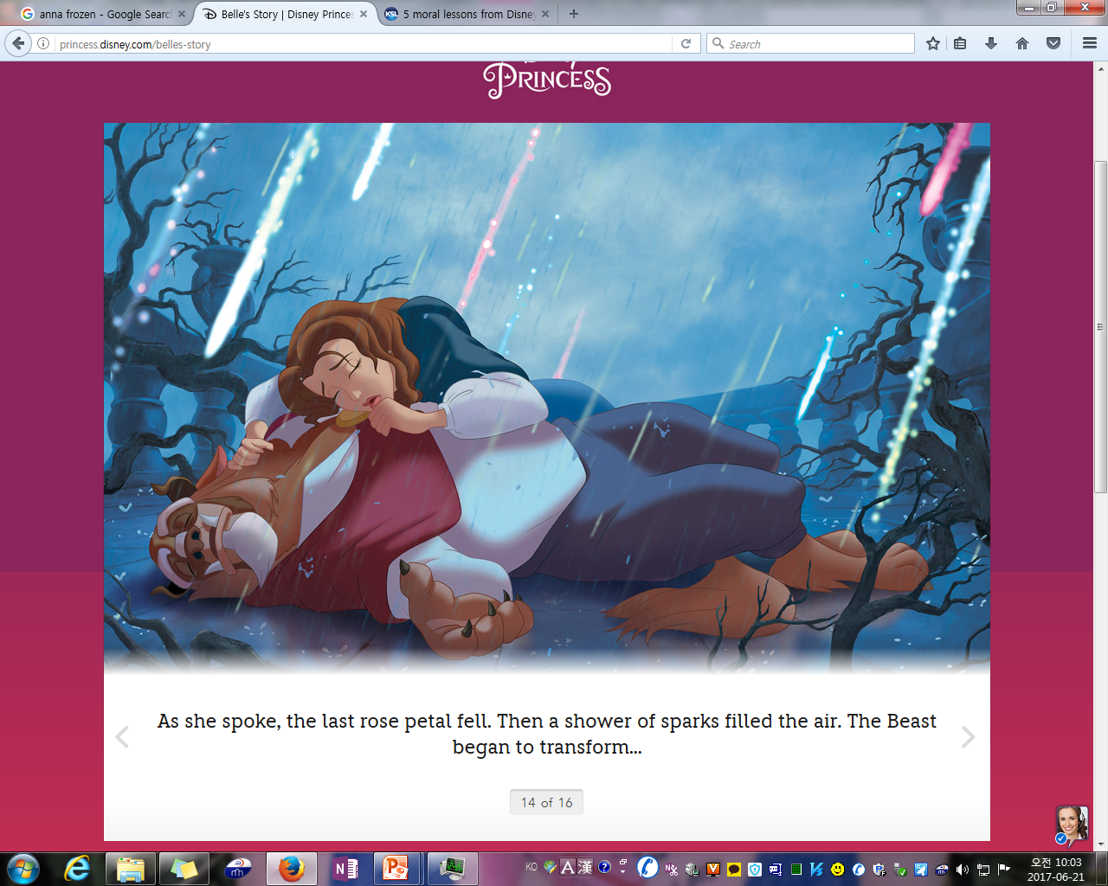
Write 4 sentences. +10 each sentence

Slide 35
콩쥐 팥쥐

